Slide 1

Smart Contracts and Formal Verification
PowerPoint Presentation in
Blockchain Technology
Fourth Year B. Tech
Sem 8 – A1. PA15. Krishnaraj Thadesar

Slide 2
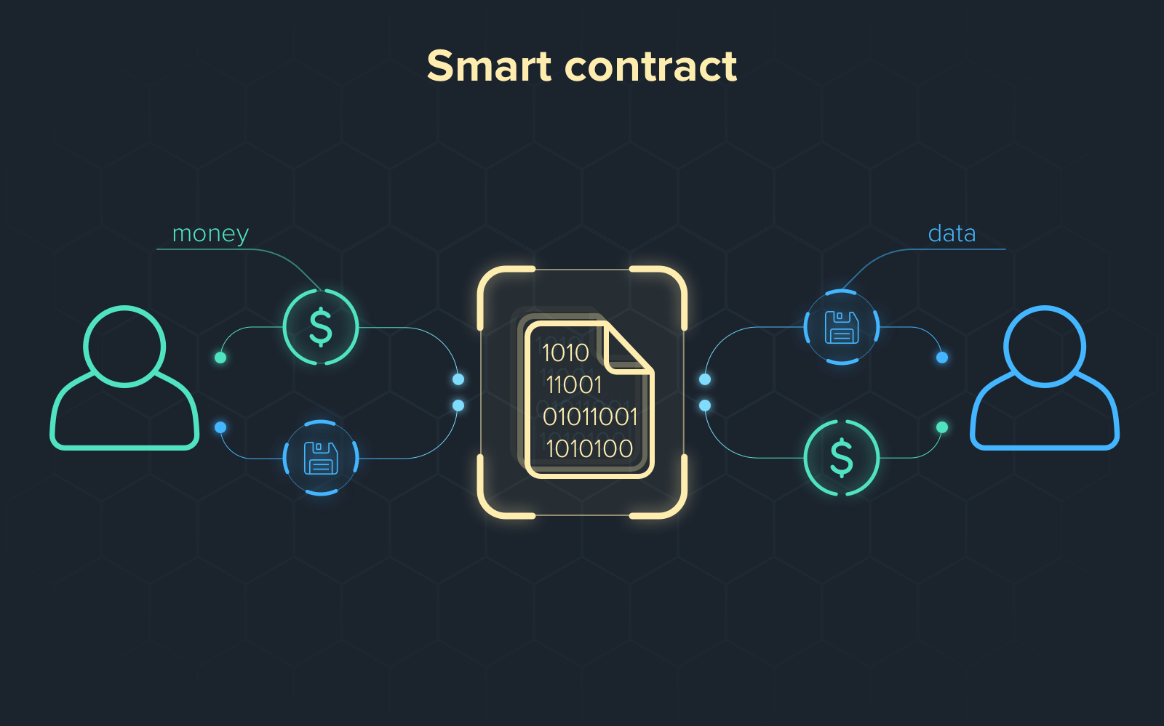
What are Smart Contracts?

Slide 3
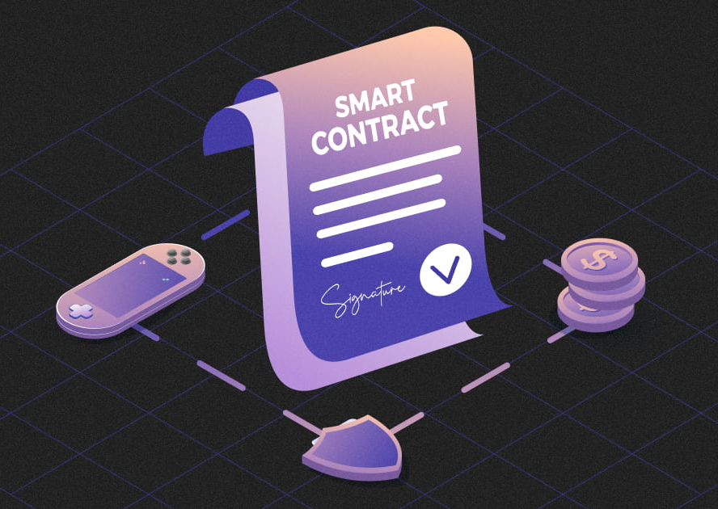
Self-executing programs deployed on blockchain platforms.
Code and state are immutable once deployed.
Run deterministically, triggered by transactions.
Popular platforms: Ethereum (Solidity), Cardano (Plutus), Tezos (Michelson).

Slide 4
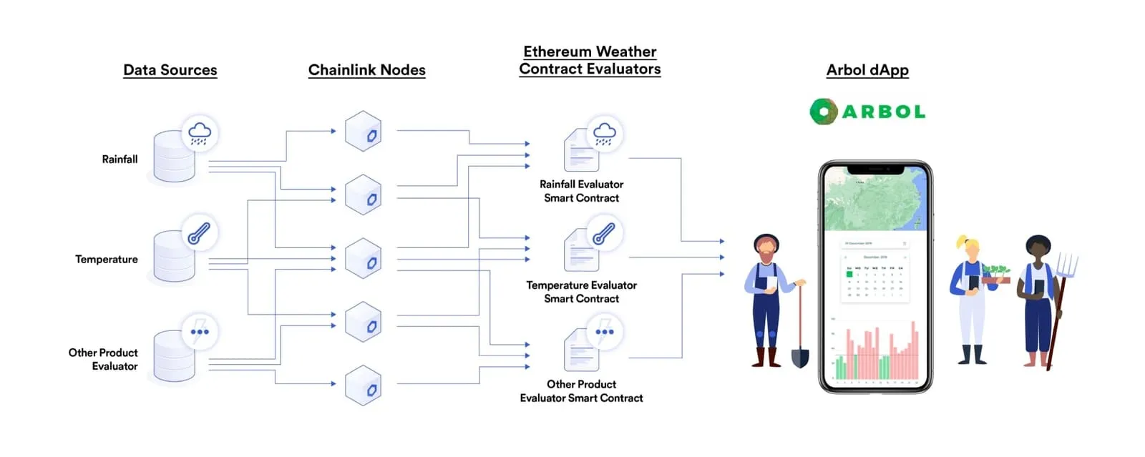

Slide 5
Common Smart Contract Vulnerabilities
Reentrancy attacks (e.g., The DAO hack, 2016)
Integer overflows/underflows (pre-Solidity 0.8.x)
Unchecked external calls and denial-of-service
Front-running and timestamp dependence
Smart contracts are non-upgradable without proxies — bugs are expensive.

Slide 6
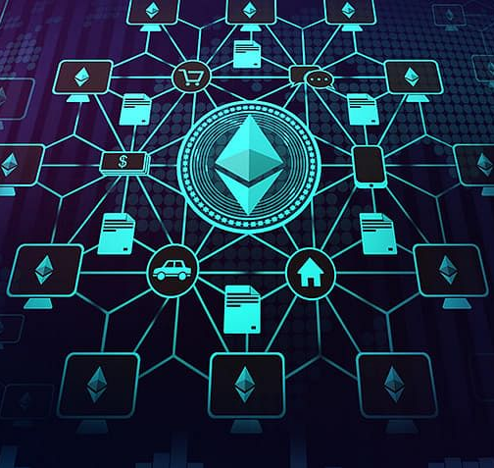
What is Formal Verification?
Mathematically proving a system satisfies a given specification.
Converts smart contract logic to logical formulas (e.g., SMT, Hoare Logic).
Ensures correctness, security, and completeness.
Avoids reliance on testing alone (which is incomplete).

Slide 7
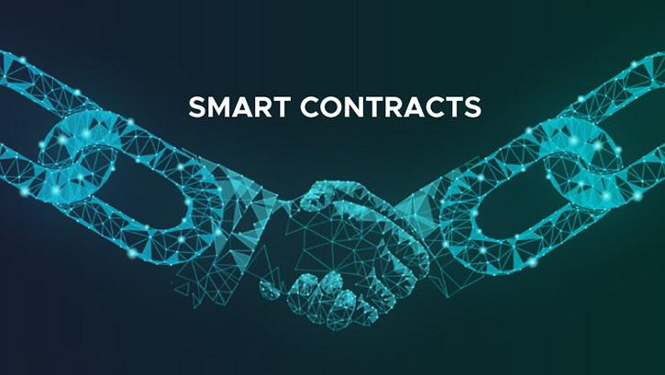
Formal Verification Process
Specification: Define properties (e.g., "Balance never goes negative").
Abstraction: Convert code to mathematical model.
Proof Generation: Use tools to verify model satisfies specs.
Result Interpretation: Confirm proof or get counterexample

Slide 8
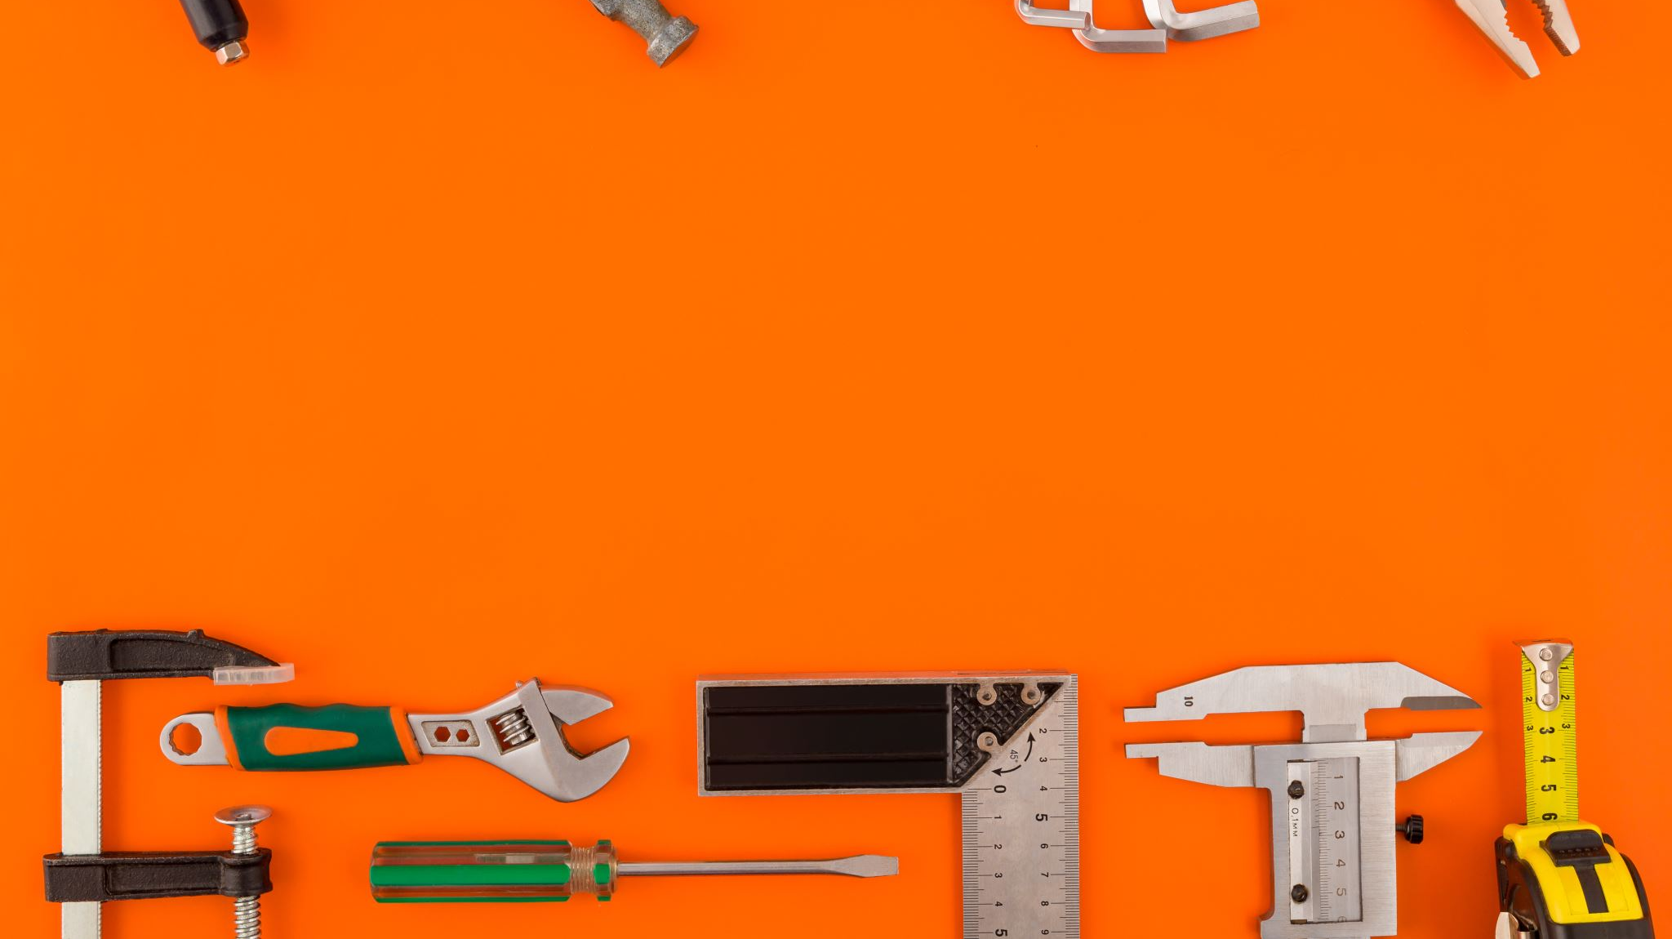
Tools and Frameworks

Slide 9
Solidity + SMTChecker (built-in with Solidity ≥ 0.5.10)
Certora Prover – Symbolic execution and formal specs (used by Aave, Compound)
KEVM – Formal semantics of EVM using K Framework
Coq / F* / Why3 – For writing and verifying critical components
VeriSmart, MythX, Manticore – for hybrid formal+symbolic analysis

Slide 10
Real-World Usage
MakerDAO: Verified modules for stablecoin logic.
Tezos: Supports formal verification at protocol level.
Algorand: Smart contracts in PyTeal can be verified using Coq-based tools.
Audits of large DeFi protocols increasingly include formal proofs.

Slide 11
Conclusion
Smart contracts handle billions in value — correctness is critical.
Formal verification provides stronger guarantees than testing or audits.
Tooling is improving but still requires mathematical expertise.
Future: More user-friendly formal methods integrated in dev pipelines.

